Slide 1
Heart Attack Analysis and Prediction
By Kim Kibo

Slide 2
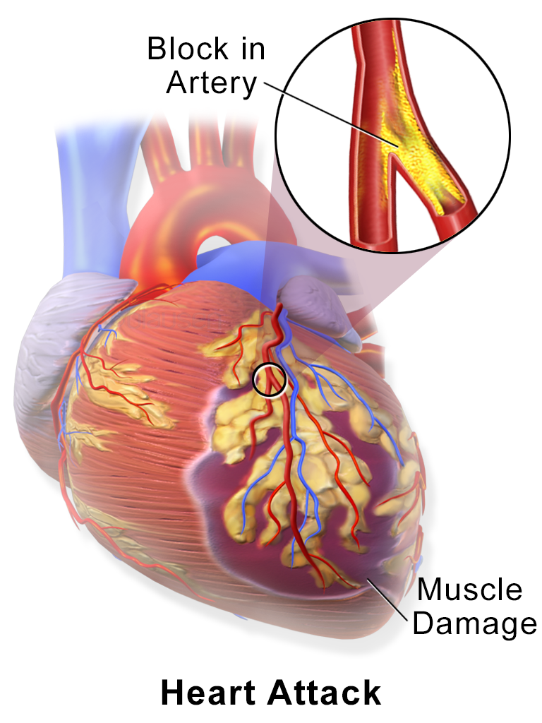
What is a heart attack?
According to the Center of Disease Control (CDC), a heart attack happens when a part of the heart muscles doesn’t get enough blood. The more time that passes without treatment to restore blood flow, the greater damage to the heart muscle.

Slide 3
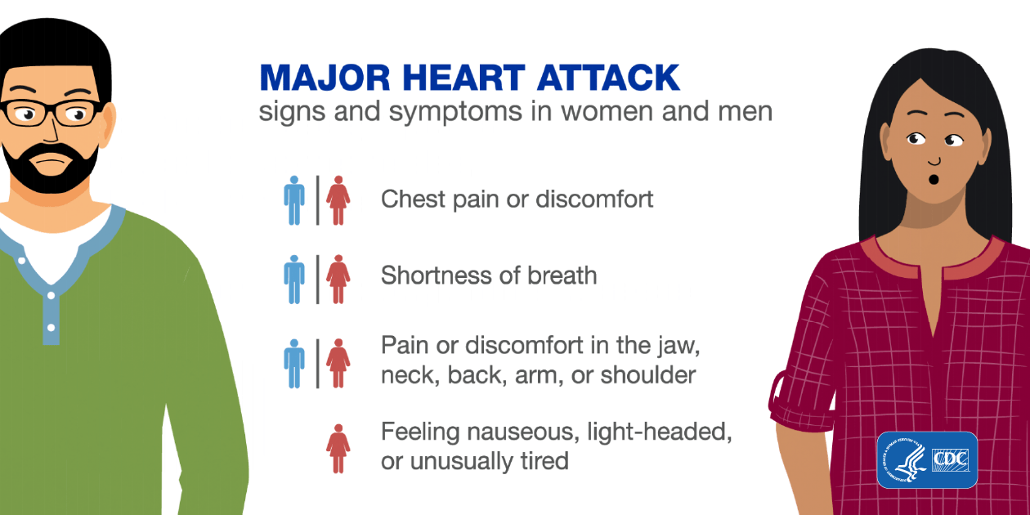

Slide 4
Risk Factors
Age (men aged 45 or older, women 55 or older are more likely to have a heart attack)
High blood pressure
High blood cholesterol
Obesity
Diabetes
Metabolic syndrome
Family history of heart attacks
Lack of physical activity
Tobacco or drug use
Stress
Autoimmune condition

Slide 5
About the data
Data is from University Hospital, Switzerland (Kaggle.com)
303 rows (people)
14 columns
Classification problem
Predicting for whether one is more or less likely to have a heart attack

Slide 6
Definitions
age - age of person
sex - male or female (1 = male, 0 = female)
cp - chest pain type (1 = typical angina, 2 = atypical angina, 3 = non-anginal pain, 4 = asymptomatic)
trtbps - resting blood pressure (in mmHg)
chol - cholesterol in mg/dl
fbs - fasting blood sugar
restecg - resting electrocardiographic results
thalacch - maximum heart rate achieved
exng - exercise induced angina (angina means chest pain 1 = yes, 0 = no)
oldpeak - ST depression on electrocardiogram induced by exercise relative to rest
slp - slope of the peak of exercise (1 = upsloping, 2 = flat, 3= downsloping)
caa - number of major vessels (0-3)
thall - thal rate
output - target variable (0 = less likely to have a heart attack, 1 = more likely to have a heart attack)

Slide 7
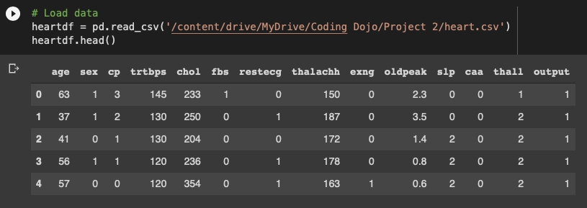
Cleaning steps

Slide 8
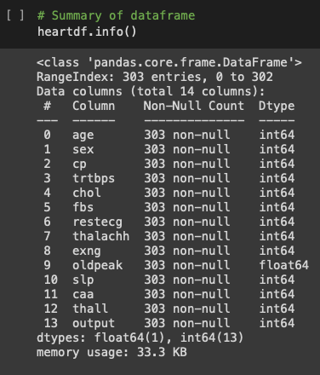
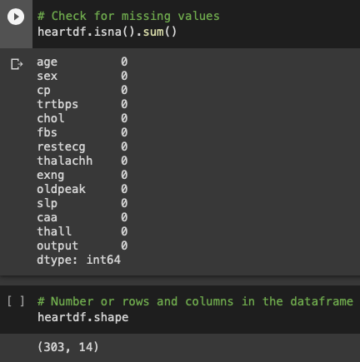

Slide 9
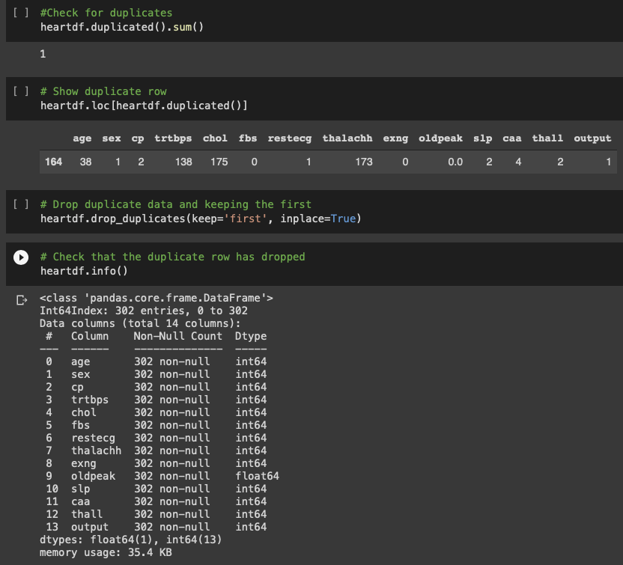

Slide 10
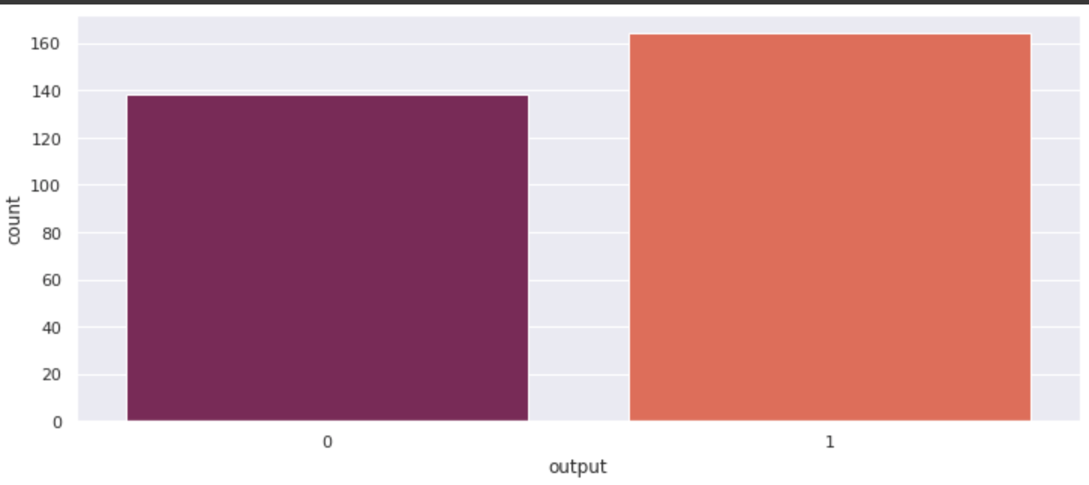
Less or More Likely to Have a Heart Attack (0 =less, 1 = more)

Slide 11
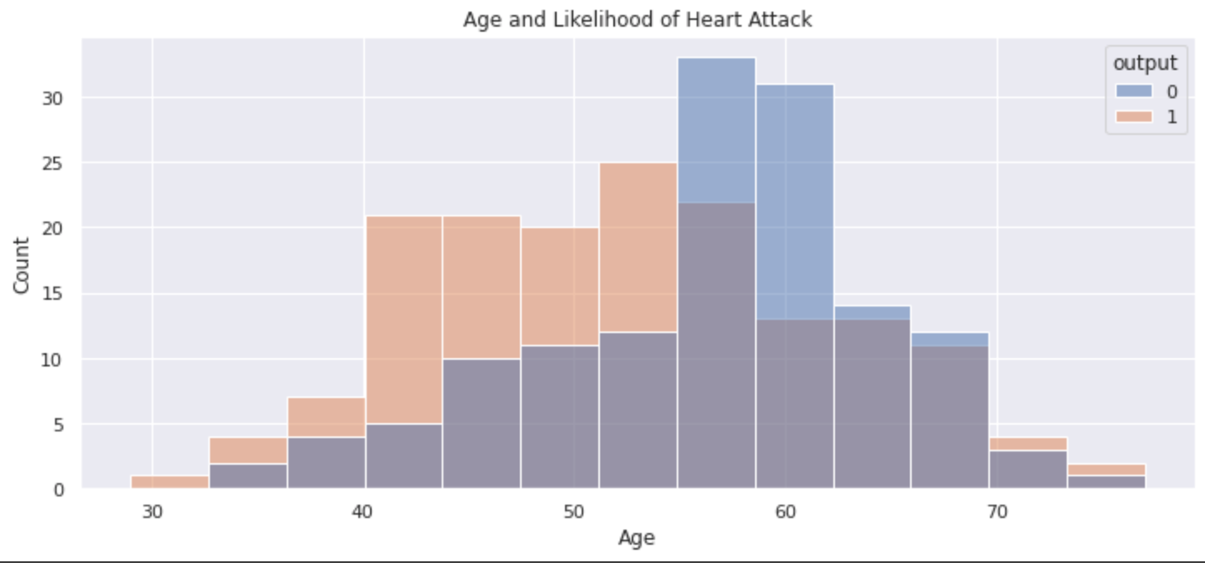

Slide 12
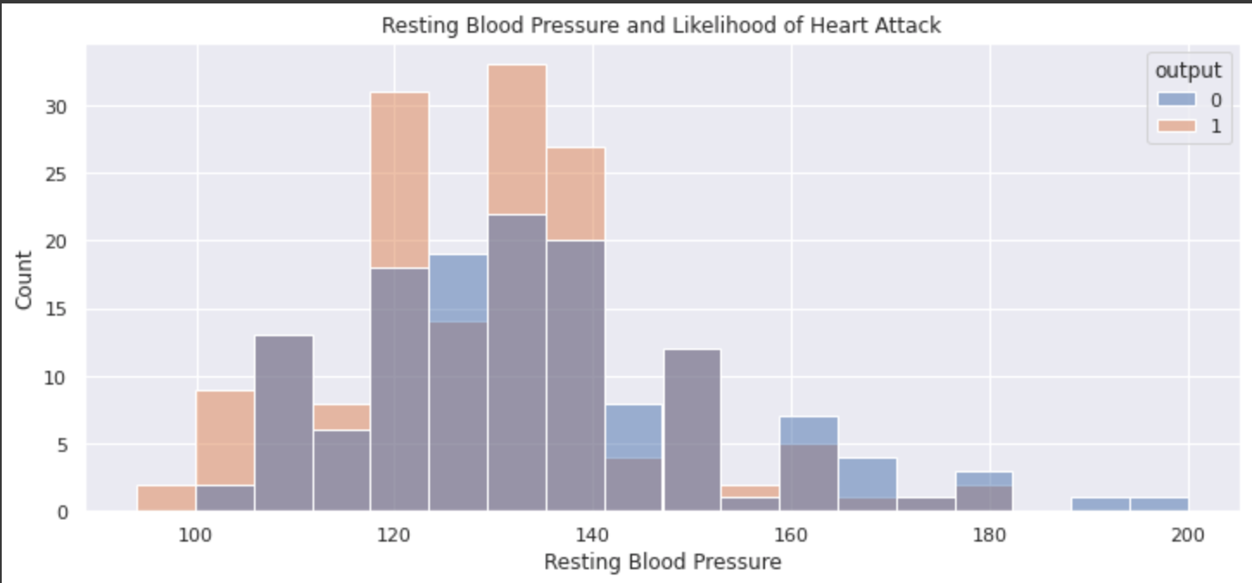

Slide 13
Findings
Logistic regression model is best fitting model at predicting whether one is more or less likely to have a heart attack.
I have tried other classification models (KNN, Random Forest, Bagged Trees) but it has scored the highest in accuracy. Logistic regression model also works well with a binary classification problem.
The accuracy is 88.1%.
It can identify whether one is more or less likely to have a heart attack 90.2% of the time.

Slide 14
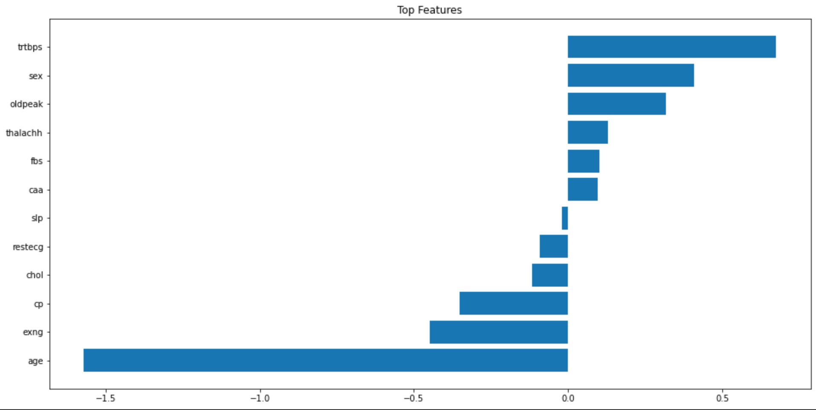

Slide 15
Final recommendations
The data sample or features can be expanded with more biomedical variables to better a model to predict heart attacks. It can include body fat percentage, measurement of daily physical activity, whether one has had a heart attack, and other risk factors.
Logistic Regression is a very useful Machine Learning tool for predicting classification of biomedical data.
Logistic Regression model can be a helpful model for diagnostic and preventive measures in heart attacks as it matches up with some of its risks explained earlier.

